Slide 1
Extending Node . js

Slide 2
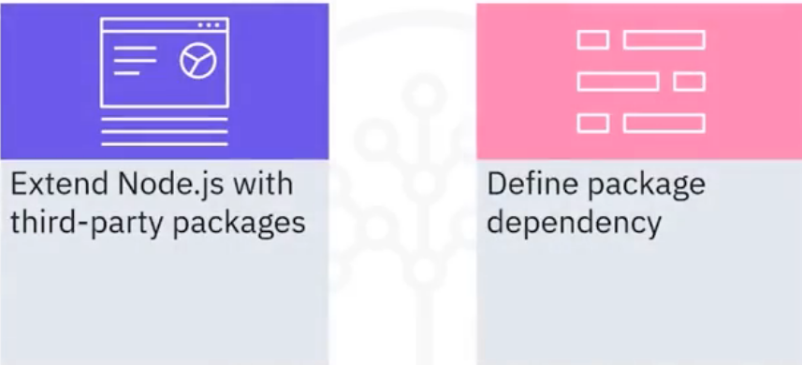
What you will learn

Slide 3
Extend with third-party packages
• The default Node.js framework provides a limited set of
features for building web applications
• For example, Node.js does not provide a parsing function for
extensible markup language (XML) messages
• In simple messages, you can parse out an XML message with
JavaScript string functions
• You can also use an XML document object, but the object is not
efficient in parsing a stream of XML data
• Developers rely on third-party packages to extend Node.js
features

Slide 4
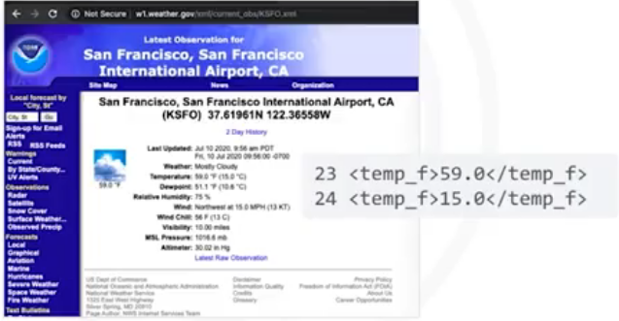
Send an HTTP request to get data
• Send an HTTP request to
https://wl.weather.gov/xml/current obs/KSFO.xml

Slide 5
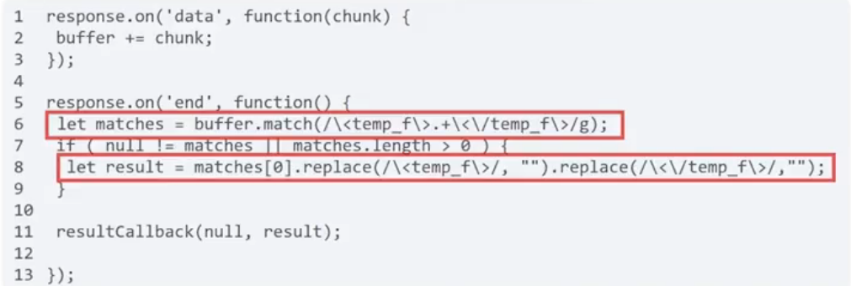
Parse web service messages
• Match a substring that starts and ends with the <temp_f> XML
element tags

Slide 6
Disadvantages of manual parsing
• String matching ignores the structure of XML data
• The message body might contain malformed XML data
• Depending on the complexity of the XML data, string matching
might be more efficient than building an XML tree of the data
• String matching is less tolerant to changes in the XML data
structure
• If the message adds or removes any XML elements, you must
change the regular expression on the string match function

Slide 7
Parse XML elements to JavaScript
• The xm12js Node.js package parses a string of XML elements
into a JavaScript object
• Unlike other XML parsing Node.js packages, xm12js uses only
JavaScript
• It does not require an XML parsing library that is written in
another language
• Third-party packages might have a different software license
than the Node.js framework
• Confirm that the licensing terms work with your company and
your application before installing the package

Slide 8
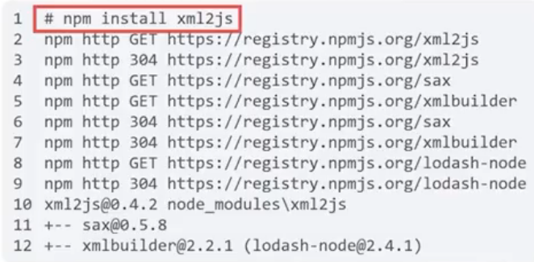
Install packages with npm
• The npm application
manages Node.js packages
in your Node framework
installation
• Run the npm install
command to retrieve and
set up a Node.js package
and any package
dependencies

Slide 9
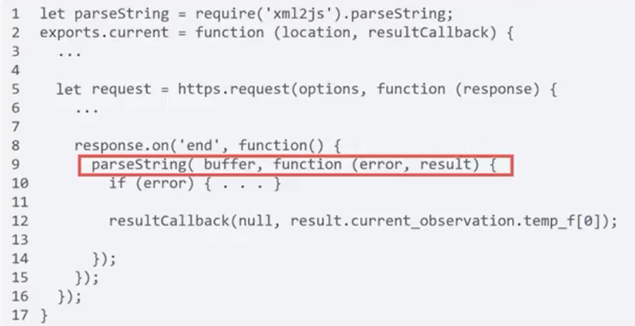
Import the package
• The parseString function runs
the callback function when
it finishes processing the
XML tree in buffer

Slide 10
Recap
In this video, you learned that:
• Developers rely on third-party packages to extend Node.jsls
features
• String matching ignores the structure of XML data
• The xm12js Node.js package parses a string of XML elements
into a JavaScript object
• The npm application manages Node.js packages in your
Node.js framework installation

